Slide 1
Sprint 2 report:
Stages of features transformation
from plain HTML
Binh, Nina

Slide 2
Structure of the
Austrian project code

Slide 3
General workflow
Stage 0: Run setup.py using setuptools
Stage 1: Starts with data collection (spider.py),
Stage 2: Feature generation (generate_features.py)
Stage 3: Model training (train.py),
Stage 4: Site verification (verify.py)
Stage 5: Presenting results in a dashboard (dashboard.py).
The helper_classes directory provides necessary utility functions across these stages. site_database.py manages database-related tasks throughout the process.

Slide 4
Structure of the Austrian project code
|-- dashboard.py
|-- generate_features.py
|-- helper_classes
| |-- DatabaseConnection.py
| |-- HTMLprocessing.py
| |-- TableProcessing.py
|-- scrapy_spider
| |-- spider.py
|-- setup.py
|-- site_database.py
|-- train.py
|-- verify.py
dashboard.py use ML models to generate risk scores for websites (safe/fake). It also includes model explainability aspects (such as LIME and SHAP) and interacts with external APIs for validation and archiving => combines data analysis, visualization, and web scraping
generate_features.py uses AggregateShops and ProcessDataframes to process and extract data from directories containing HTML files of safe and fake shops. The script transforms this data into a DataFrame and saved as features.csv, ready to be fed to ML model
spider.py has three web crawling spiders extracting different types of web content. The CssSpider is used for extracting CSS and JavaScript files, the ImgSpider is used for downloading images, and the HtmlSpider retrieves HTML content from websites. These spiders are capable of handling different file types

Slide 5
Structure of the Austrian project code
|-- dashboard.py
|-- generate_features.py
|-- helper_classes
| |-- DatabaseConnection.py
| |-- HTMLprocessing.py
| |-- TableProcessing.py
|-- scrapy_spider
| |-- spider.py
|-- setup.py
|-- site_database.py
|-- train.py
|-- verify.py
DatabaseConnection.py connects to a PostgreSQL database. It provides connect and disconnect methods to establish and terminate connections, doing operations like querying and data manipulation
HTMLprocessing.py contains methods for processing and analyzing HTML content from websites. This is the main file for feature extraction and data processing and transformation
TableProcessing.py includes functions to create and drop database tables, insert and delete records, and remove duplicates. Additionally, it provides a method to retrieve a fraud score for individual sites for decision-making process.

Slide 6
Structure of the Austrian project code
setup.py sets up a Python package mal2_fakeshop_models, which includes modules for fake-shop detection and a dashboard builder.
|-- dashboard.py
|-- generate_features.py
|-- helper_classes
| |-- DatabaseConnection.py
| |-- HTMLprocessing.py
| |-- TableProcessing.py
|-- scrapy_spider
| |-- spider.py
|-- setup.py
|-- site_database.py
|-- train.py
|-- verify.py
site_database.py uses the DatabaseConnection and TableProcessing classes from the helper_classes module to execute database tasks
train.py trains ML models which includes Decision Tree, Random Forest, Neural Networks, and XGBoost, processing HTML data through feature extraction and vectorization. The script saves trained models, vectorizers, and generates evaluation metrics and plots (ROC, DET, TSNE) to assess model performance.
verify.py predicts websites as fake or safe using the pre-trained ML model from train.py. It checks if the site is already verified in a database, scrapes the website's HTML, CSS, and images, and then uses models like XGBoost for prediction. Additionally, it can generate feature importance explanations using LIME or SHAP

Slide 7
Structure of the Austrian project code
Other non-python section folders:
dashboard: Directory containing generated dashboard HTML files and images
docker: Contains Docker-related files like Dockerfile and scripts
docs: Contains documentation files like installation guides in PDF format
files: Stores various metric and plot images generated by the scripts
resources: Includes various resources like images and HTML templates for the dashboard
|-- dashboard.py
|-- generate_features.py
|-- helper_classes
| |-- DatabaseConnection.py
| |-- HTMLprocessing.py
| |-- TableProcessing.py
|-- scrapy_spider
| |-- spider.py
|-- setup.py
|-- site_database.py
|-- train.py
|-- verify.py

Slide 8
What features are extracted from the Austrian project?

Slide 9
Crawling and scraping (spider.py) | Purpose, tags, attributes and allow list
CSS Spider | Purpose: Extracts CSS and JavaScript files from web pages. Tags: targets HTML tags <script>, <link>, <img>, <style>, <picture>, <svg>, <a> and their attributes src, href. Example: <a href="https://example.com">Visit our site</a> <img src="image.jpg" alt="Example Image"> Allow list: Filters URLs to include only those ending in .css and .js.
IMG Spider | Purpose: Downloads images from web pages. Tags: targets HTML tags <img>, <link>, <style>, <picture>, <source>, <svg>, <a>) and their attributes src, href, srcset. Allow list: Filter images ending in .png, .jpg, .jpeg, .tif, .tiff, .gif, .jif, .jfif, .svg, .webp.
HTML Spider | Purpose: Scrapes HTML content from web pages.

Slide 10
HTML Tags, Attributes, (soup2html_tags) | - The method soup2html_tags extracts all HTML tags, their attributes, and the values of those attributes from a website.
CSS Content (css_in_path) | - The css_in_path method searches for CSS files in the specified paths and concatenates the text content of all CSS files into a single string.
JavaScript Content (js_in_path): | - The content of JavaScript files is concatenated into a single string and stored in the js column of the DataFrame.
Comments in HTML (soup2comment): | - The soup2comment method extract comments from the HTML.
N-Gram (soup2ngram): | - This method creates 3-grams, 4-grams, and 5-grams of HTML tag relationships, which represents connections between parent and child tags
Tag Relationships (soup2children): | - This method represent parent-child relationships between tags and creates a graph-like structure of the HTML document
ProcessDataframes | transforming all these above features into TF-IDF vectorization.

Slide 11
Current work progress

Slide 12
Stage 1: Gathering random HTML sites (not including .css and .js)

Slide 13
Stage 2: Extract HTML text, comments, tag counts,
tags and attributes,
embedded JS in <script> tag, embedded CSS in <style> tag

Slide 14
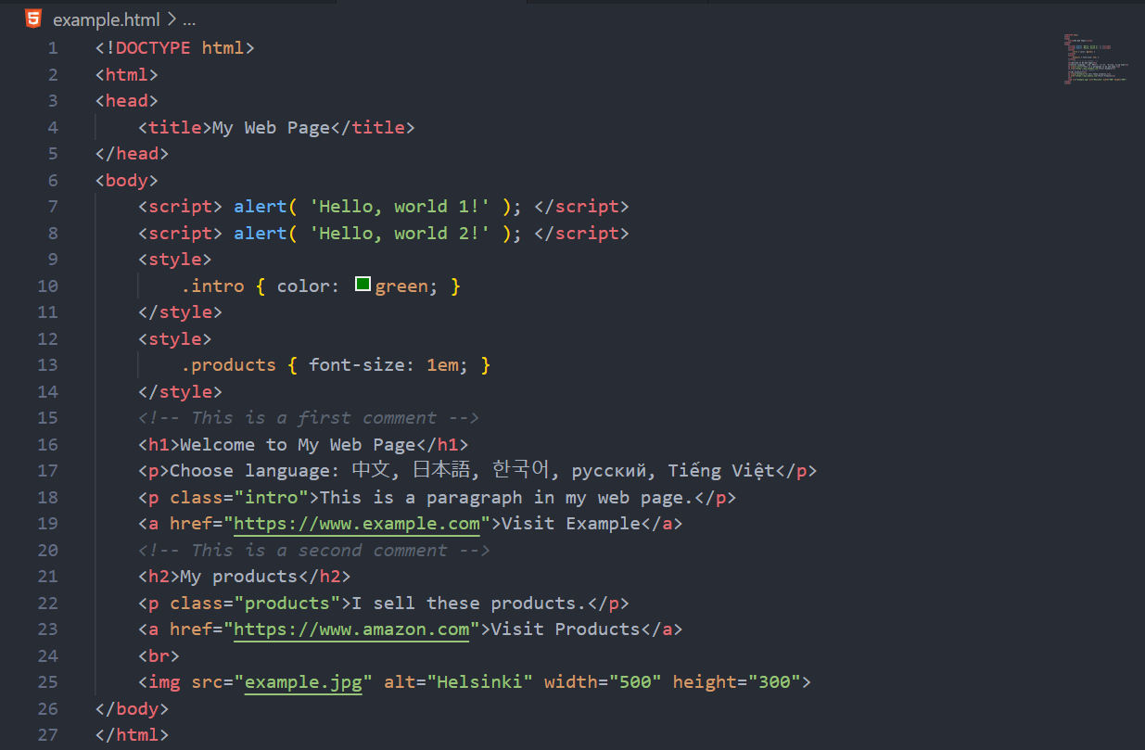
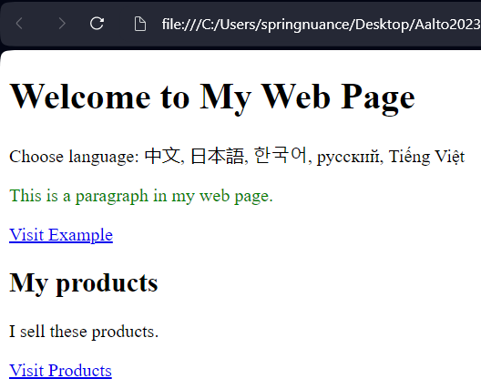

Slide 15
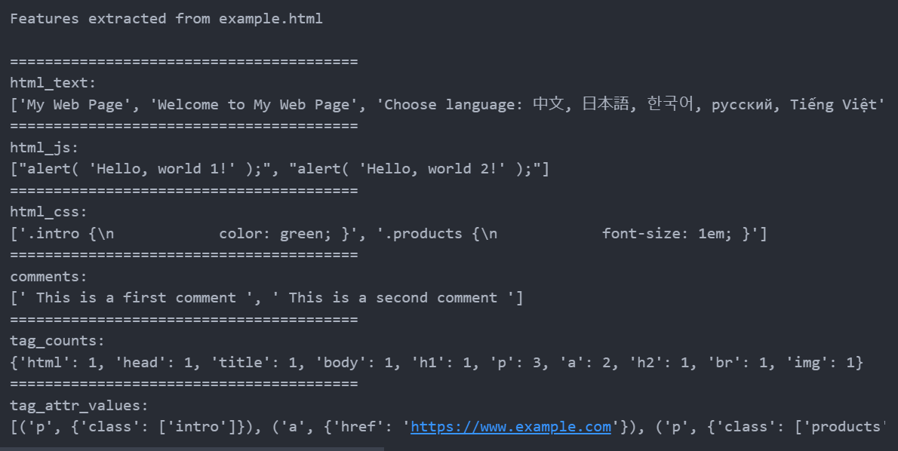
This is just a speculative output. To be exact, we must see the output format by Joonas

Slide 16
Stage 3: Feature processing

Slide 17
What scraping data
required from the team?

Slide 18
{"url":"https://crawler-test.com/mobile/responsive",
"date":"2023-11-20T13:56:05.604946",
"titles":["Responsive only page"],
"meta":{"":[{"text":"","attrs":{"content":"en","http-equiv":"content-language"}},{"text":"","attrs":{"content":"Default description GMqV4KiWkKQVRtWCYDHF","name":"description"}},{"text":"","attrs":{"name":"viewport","content":"width=device-width, initial-scale=1.0"}}]},"urls":["https://crawler-test.com/"],
"text":{"content":["Sed ut perspiciatis unde omnis iste natus error sit voluptatem accusantium doloremque laudantium, totam rem aperiam, eaque ipsa quae ab illo inventore veritatis et quasi architecto beatae vitae dicta sunt explicabo."],
"full_text":["Crawler Test two point oh!","Consistent H1 Header Group A 2","Sed ut perspiciatis unde omnis iste natus error sit voluptatem accusantium doloremque laudantium, totam rem aperiam, eaque ipsa quae ab illo inventore veritatis et quasi architecto beatae vitae dicta sunt explicabo.","GMqV4KiWkKQVRtWCYDHF"]},
"images":[],
"svgs":[],
"css":
{"inline":[],
"external":[{"text":"","attrs":{"type":"text/css","href":"/css/app.css","rel":["stylesheet"]}}]},
"js":
{"inline":[{"text":"(function(w,d,s,l,i){w[l]=w[l]||[];w[l].push({'gtm.start': new Date().getTime(),event:'gtm.js'});var f=d.getElementsByTagName(s)[0], j=d.createElement(s),dl=l!='dataLayer'?'&l='+l:'';j.async=true;j.src= '//www.googletagmanager.com/gtm.js?id='+i+dl;f.parentNode.insertBefore(j,f); })(window,document,'script','dataLayer','GTM-MCVXV6');","attrs":{}}],
"external":[{"text":"","attrs":{"type":"text/javascript","src":"/bower_components/jquery/jquery.min.js"}}]},
"forms":[],
"iframes":
[{"text":"<iframe src=\"//www.googletagmanager.com/ns.html?id=GTM-MCVXV6\" height=\"0\" width=\"0\" style=\"display:none;visibility:hidden\"/>",
"attrs":{"src":"//www.googletagmanager.com/ns.html?id=GTM-MCVXV6",
"height":"0",
"width":"0",
"style":"display:none;visibility:hidden"}}],
"stats":{"meta":3,"link":2,"script":2,"div":10,"

